Slide 1
Bike-Sharing Data Analysis
Divya Tom

Slide 2
Objective
To build a model to predict the number of bike that can be rented with given data set
To learn how to preprocess data, data cleaning
To study about Machine learning techniques such as Linear regression and various scikit metrices.

Slide 3
Problem Statement
A US bike-sharing provider BoomBikes has recently suffered considerable dips in their revenues due to the ongoing Corona pandemic.
The company is finding it very difficult to sustain in the current market scenario.
Company decided to comeup with a business plan to recover this scenario, to find the reason for the dip and to overcome the problem.

Slide 4
About Data
Dataset in the form of excel file.
Data set consists of data of span of 2 years(2018 & 2019)
Dataset has 730 rows × 16 columns
Dataset file is in the form of.csv
It has size of 56.1Kb

Slide 5
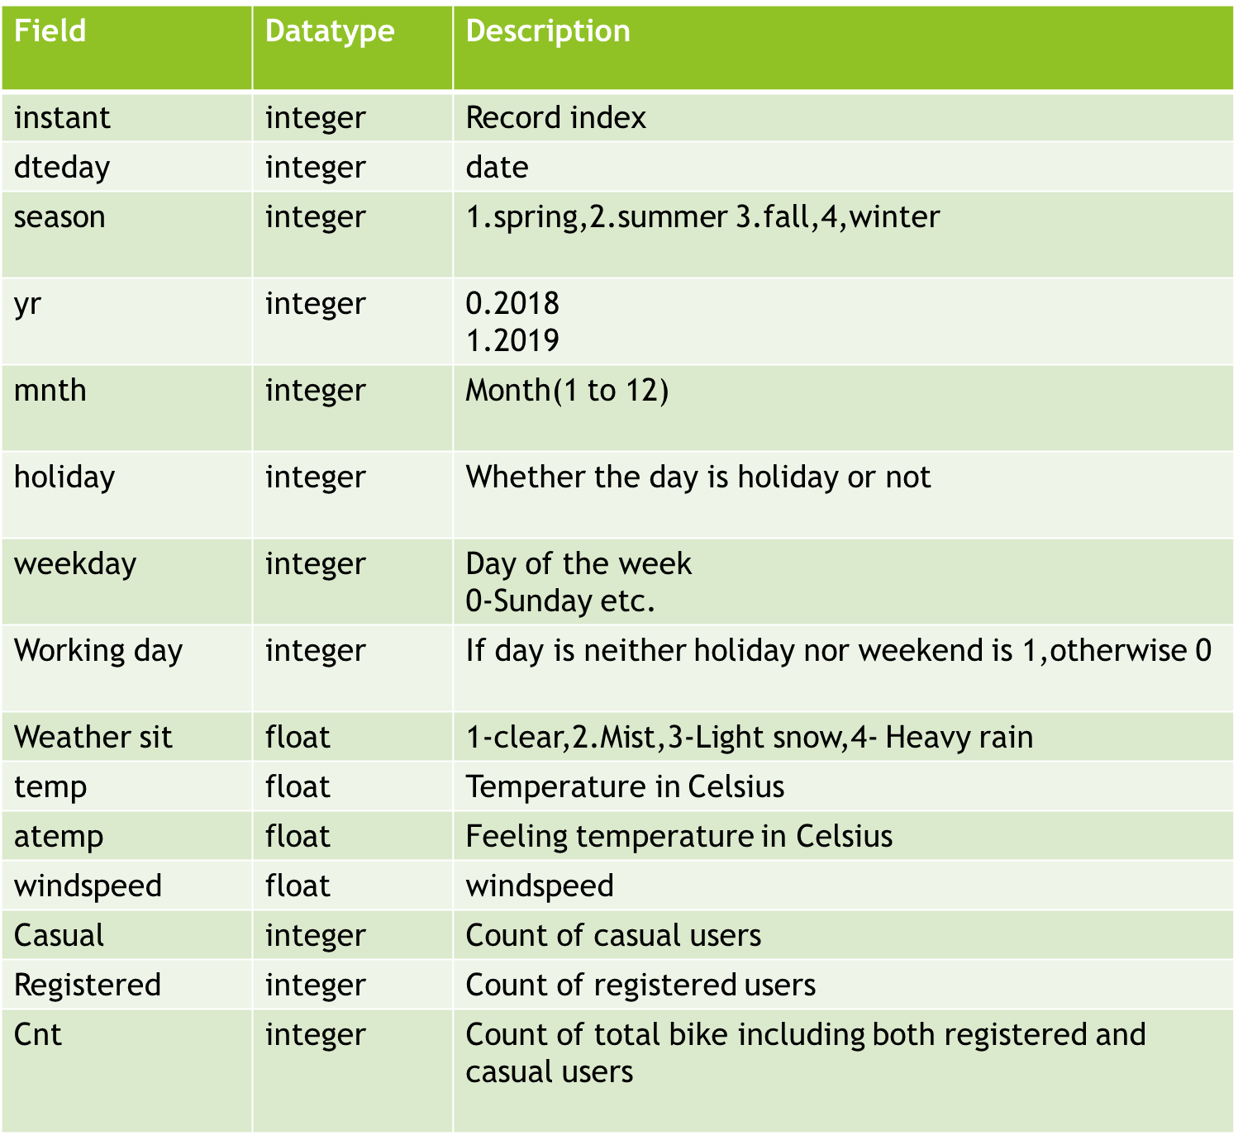
Data Description

Slide 6

Tools Used
Jupyter Notebook

Slide 7
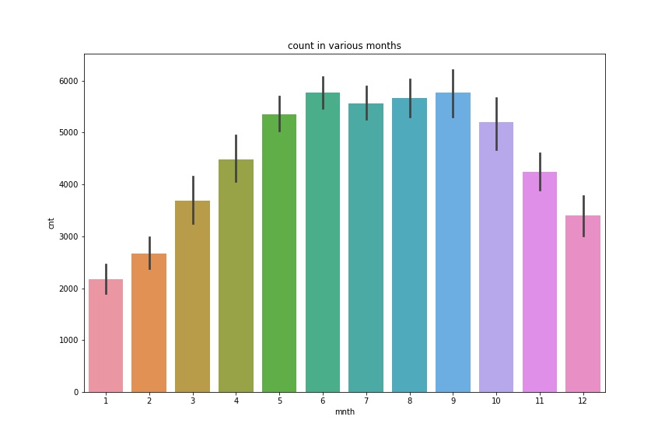
Exploratory Data Analysis
Count in various months
Counts of bikes are very less approx. of 2000 in months of January, followed by December ie, in winter season. People may find difficult to travel by bike in winter.
Counts of bikes are more in rainy season (June)

Slide 8
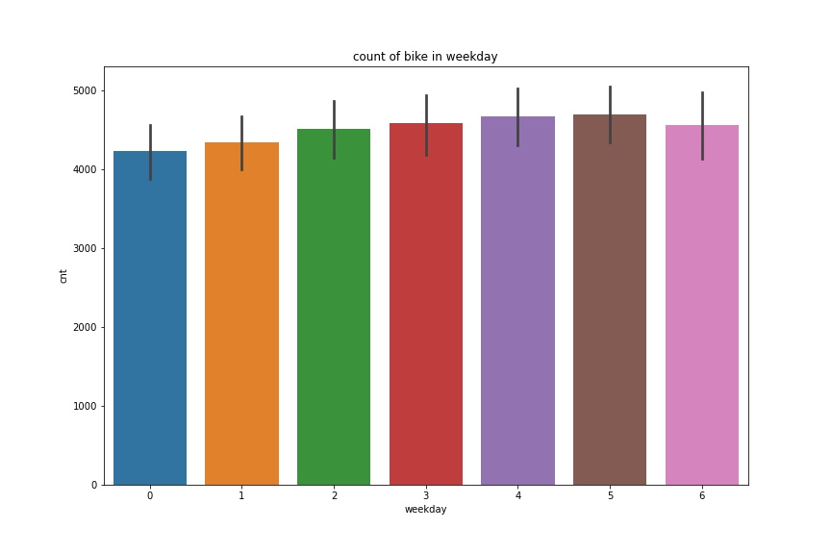
Count of bikes in week day
Almost all weekdays has same average count
But weekend has slight decrease( due to family outing or programs people prefer going by car)

Slide 9
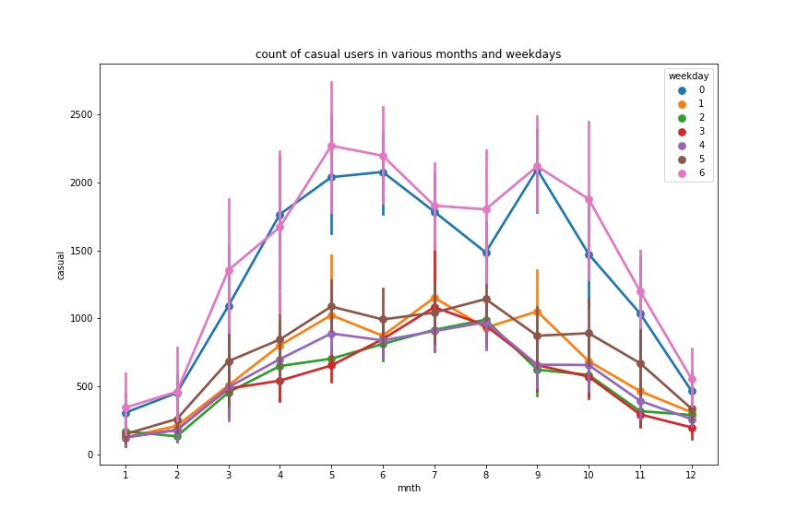
'Count of casual users in various months and weekdays
Casual users were high in count during weekends
They may find these rented bikes as means of transport for their outings

Slide 10
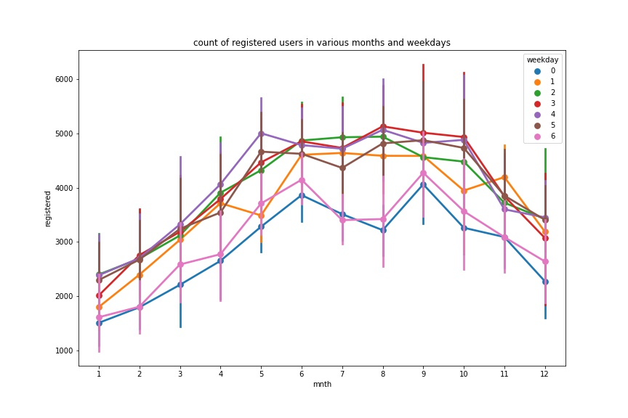
Count of registered users in various months and weekdays
Registered users were high during weekdays
They can go to office on their registered bikes, may be it be cheap and safe.

Slide 11
Machine Learning model
Multiple Linear Regression is used
To estimate the relationship between two or more independent variable and one dependent variable.
Here , independent variable or predictor_columns are 'season', 'yr', 'mnth', 'holiday', 'weekday’,workingday', 'weathersit', 'temp', 'atemp', 'hum', 'windspeed', 'casual', 'registered’
Dependent variable or target_columns=cnt /count of bikes
ie., counts of bike can be predicted using attributes of predictor columns

Slide 12
Test size is 33%
Test data : 240 observations
Train data :490 observation

Slide 13
Result
​yi​=β0​+β1​xi1​+β2​xi2​+...+βp​xip​+ϵwhere, for i=n observations: yi​=dependent variable,xi​=explanatory variables,β0​=yintercept (constant term),βp​=slope coefficients for each explanatory variable,ϵ=the model’s error term (also known as the residuals)​ Here,
Count of bikes= 3.1e-13*season+1.27e-12*yr-2.3e-14*mnth-6.5e-15*holiday+1.45e-15*weekday+6e-13 *workingday+3.8e-13*weathersit-5.3e-14*temp+3.85e-14atemp-1.03e-14hum-9.7e-15*windspeed+1 *casual+1*registerd +2.72e-12

Slide 14
Error metrices
Mean squared error(MSE)
train data- 1.73e-24((~0)
Test data-1.65e-24 (~0)
Root mean squared error(RMSE)
train data-1.3e-12 (~0)
Test data-1.2e-12(~0)
Mean absolute error(MAE)
Train data-9.95e-12(~0)
Test data-9.95e-12(~0)
Ordinary least square error/R2
Train data-1
Test data-1

Slide 15
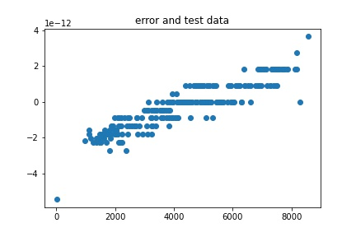
Error Vs test data is plotted
It shows positive correleation.

Slide 16
Thank you!

